Slide 1
Car Price Prediction
Car Price is one of the key factor for car owner. Some cars with Good Brand Name seems to be good value in market and some have not that much value in sale market. Its a problem for the owner or company that some cars are in more in demand and some are not

Slide 2
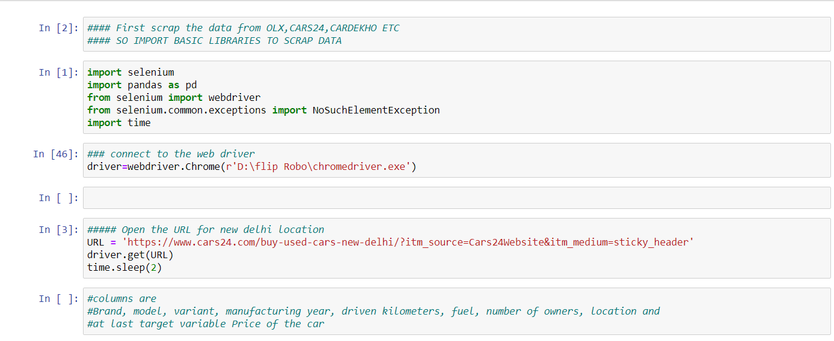
Scrapping
I have scrap the data from cars.com of different location.

Slide 3
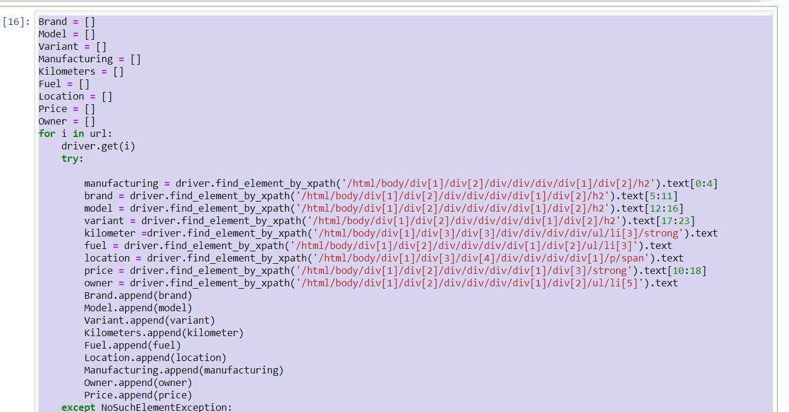
Store data in different columns

Slide 4
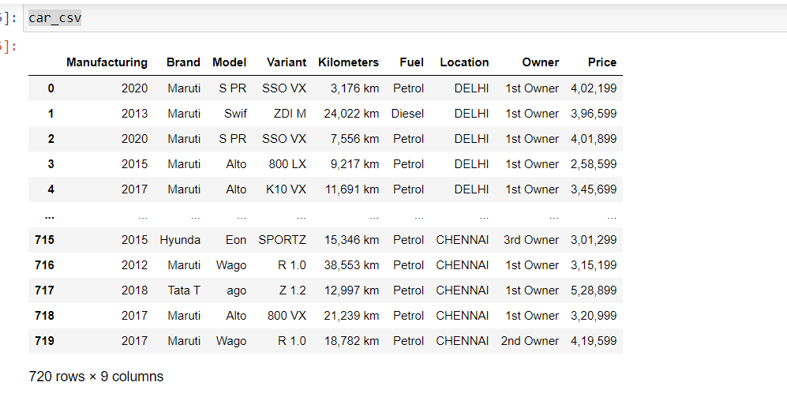
Final CSV file

Slide 5
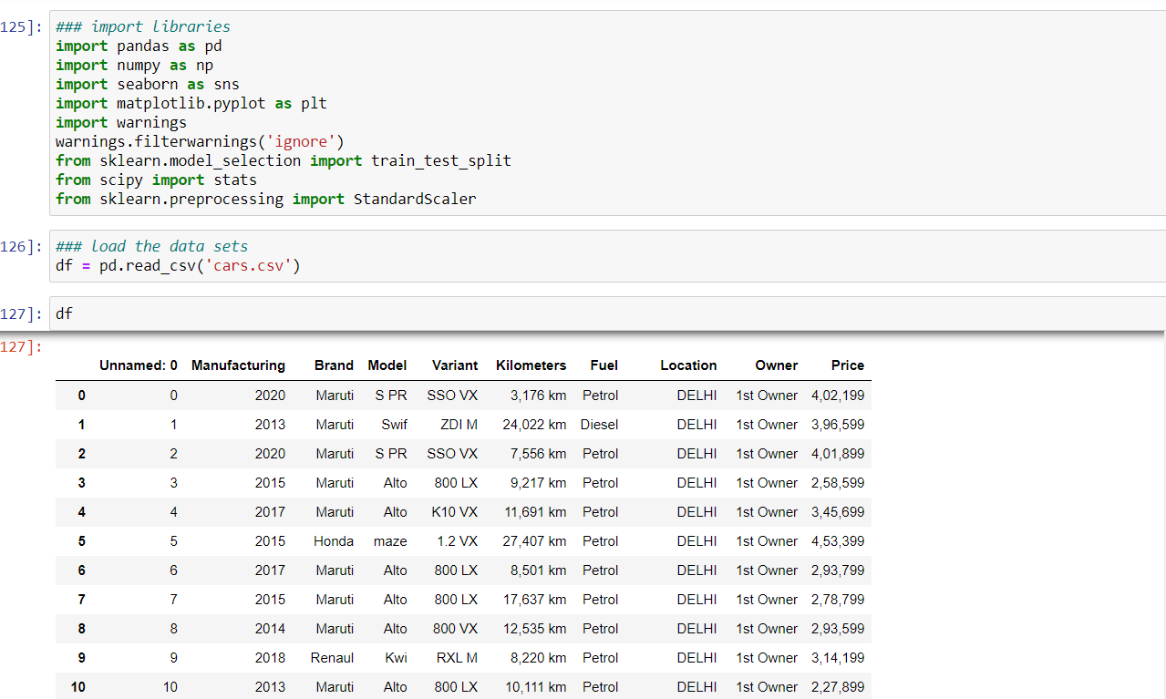
Import the libraries and load the data

Slide 6
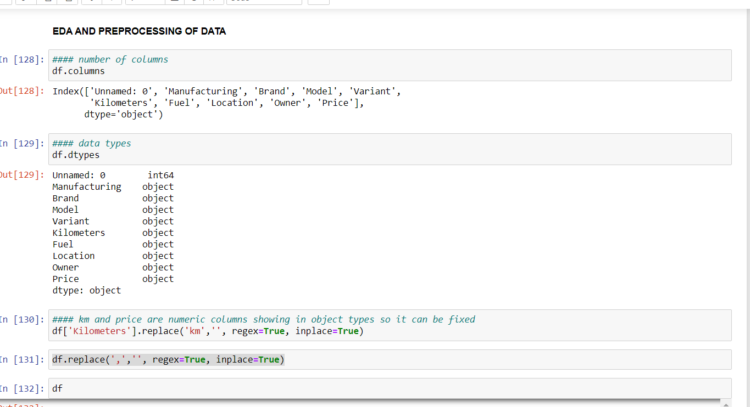
EDA and Pre-processing
EDA is most important part of data its shows the columns ,num of null values , value counts ,datatypes, statistical summary etc.

Slide 7
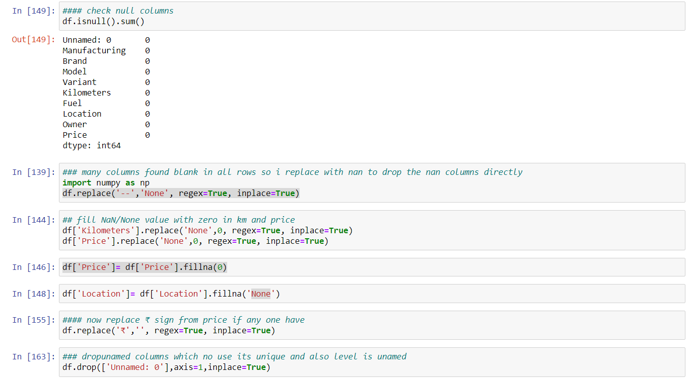
Pre-processing
Through pre-processing cleanness of data is to been done

Slide 8
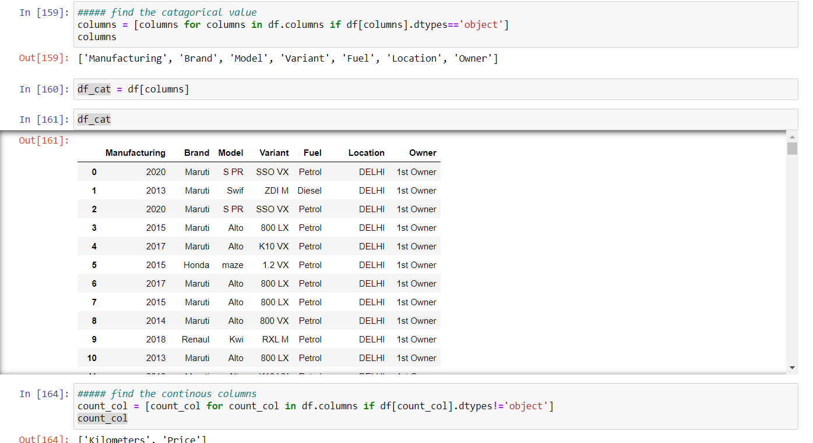
Separate the data into categorical and continuous columns and its help to keep original data safe and any mistake not lose of original one and also I can use encoding techniques as per columns

Slide 9
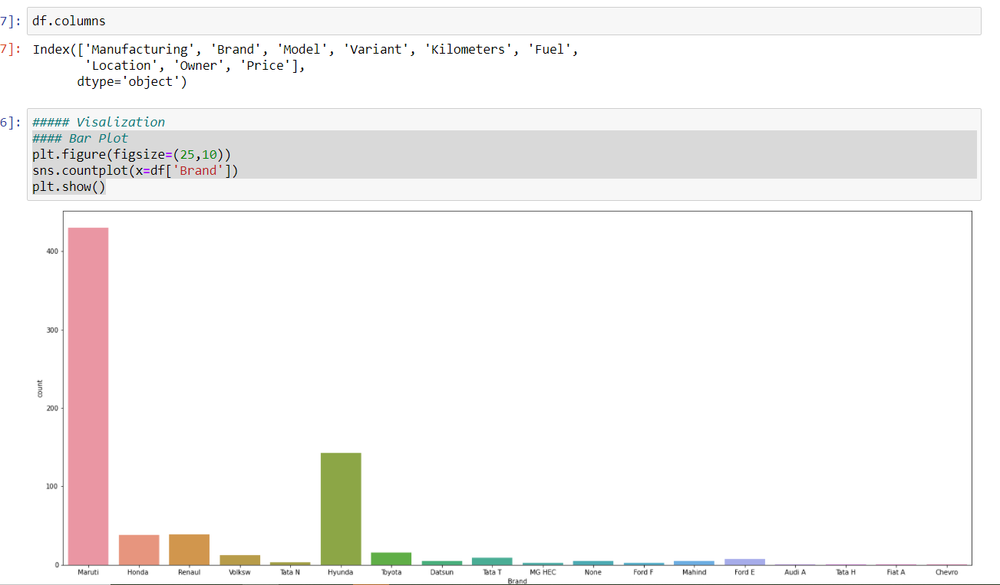
Visualization of data

Slide 10
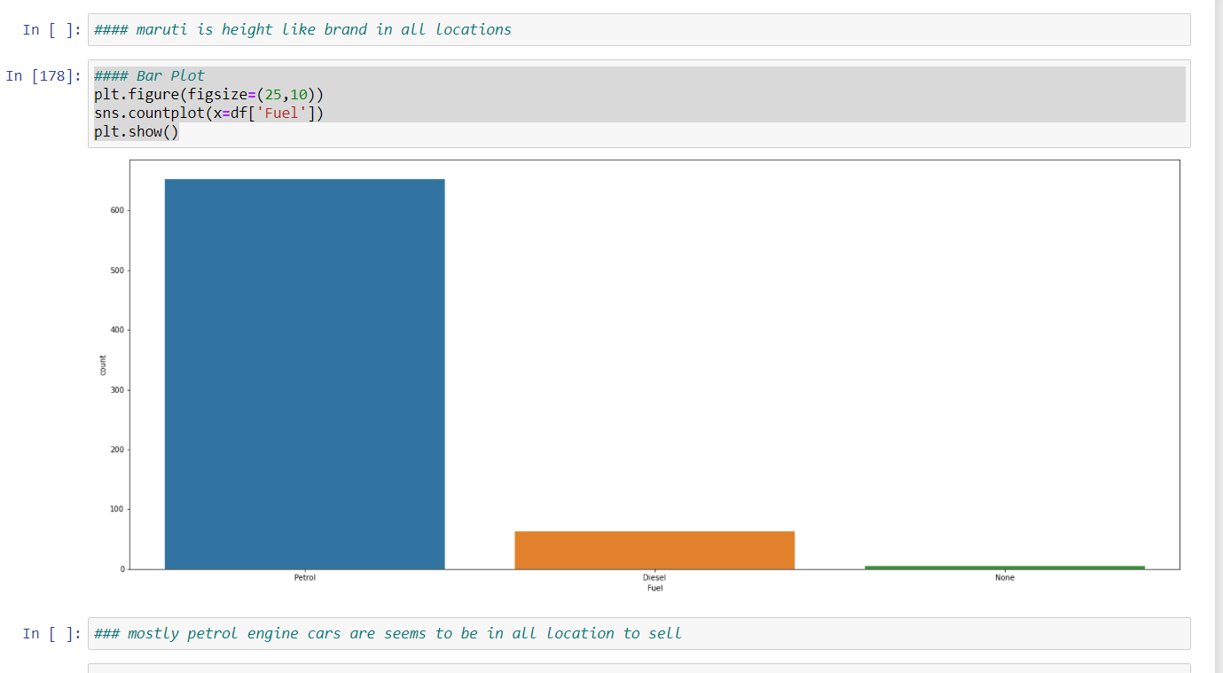
Maruti is highest selling used car and mostly petrol type car is on sale as per chart

Slide 11
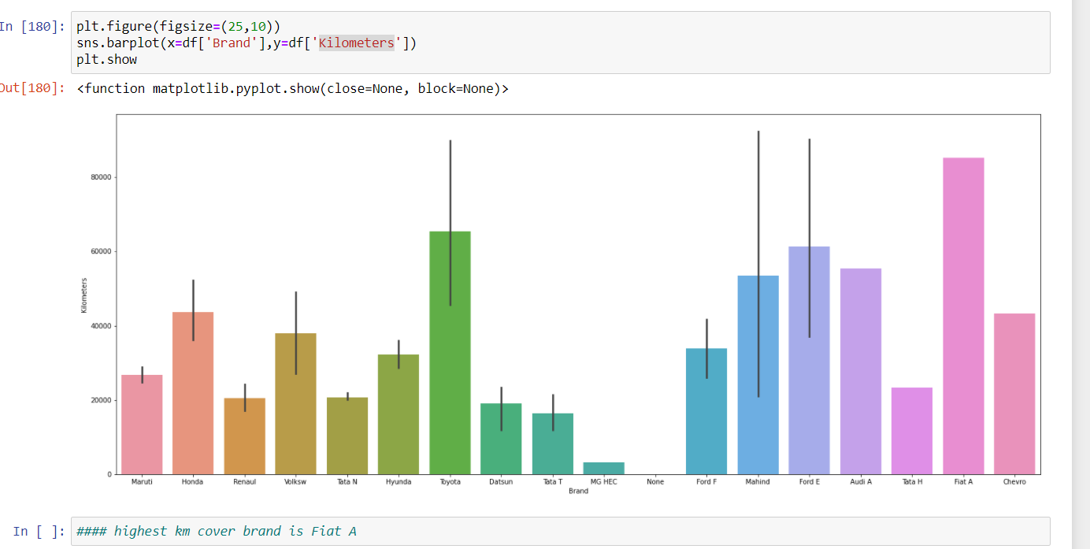

Slide 12
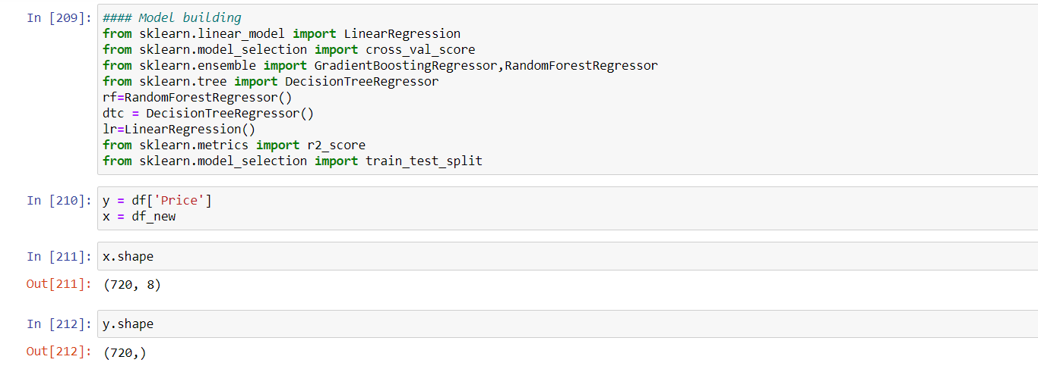
Model Building

Slide 13
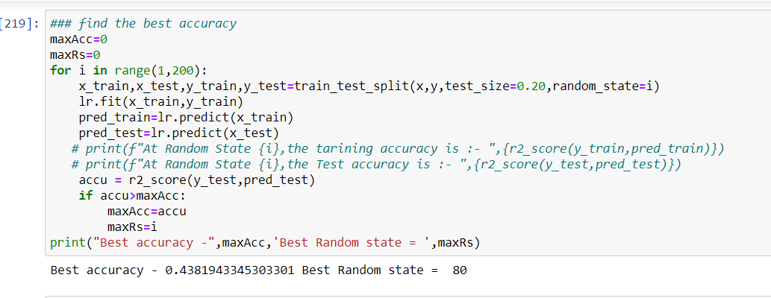
Random State

Slide 14
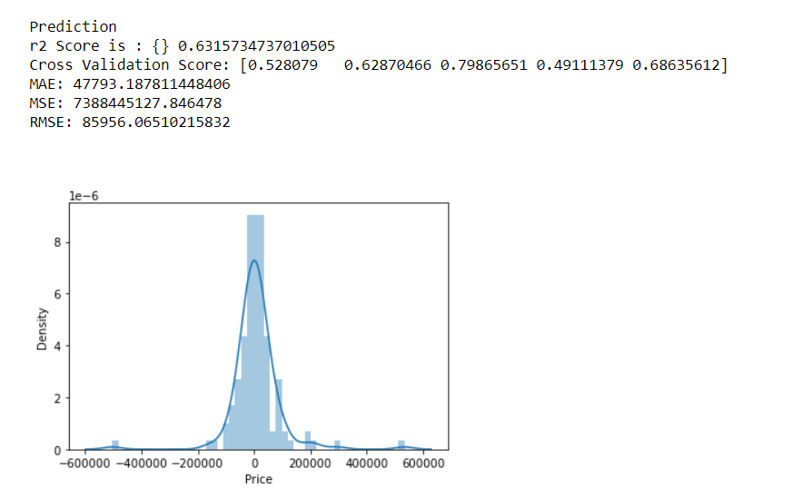
Best Model

Slide 15
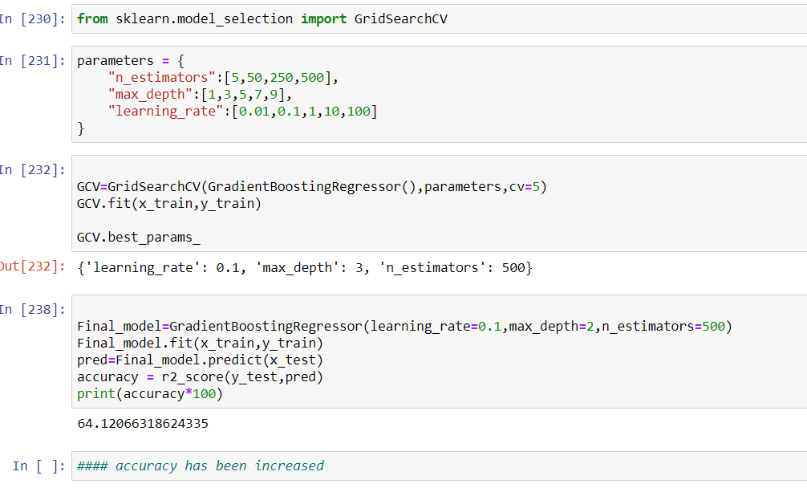
Hyper parameter tunning increase the accuracy

Slide 16
Thank You

